Slide 1

Socket Programming
Madhav Mohan

Slide 2
Agenda
Intro to Socket
Pictorial Representation of Client-Server Architecture
Breakdown of Client-Server Architecture
Client Side,
Server Side
Some Other Frequently Used APIS
Demo of Multiple Client Server Architecture
Demo of specific APIS
Send text file over the Socket
Demo of Chat Room Application

Slide 3
What is socket programming?
Socket programming is a technique to connect two devices on a network and exchange data using a common language.
Sockets are endpoints of communication that have an IP address and a port number. A server socket listens for incoming requests, while a client socket initiates a connection.
Socket programming can be done using different protocols, such as TCP or UDP. TCP is reliable and ensures that data is delivered in order and without errors. UDP is faster but does not guarantee delivery or order.
To create a socket, a program needs to use a socket API, which is a set of functions that provide access to the network layer.

Slide 4
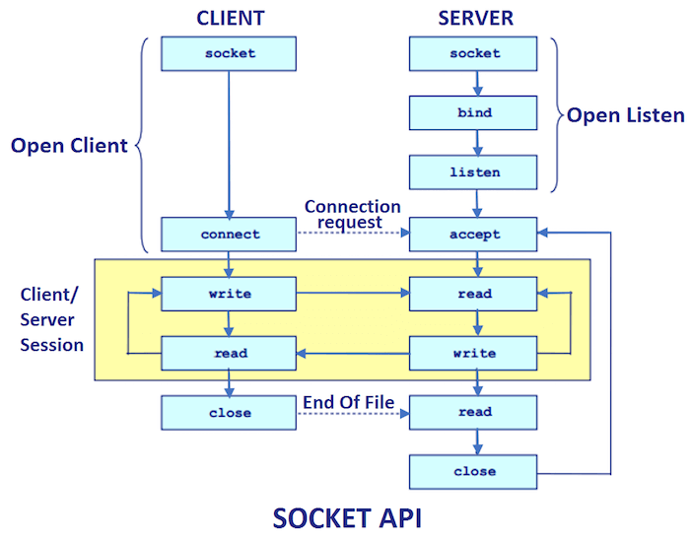
Client–Server Architecture

Slide 5
Breakdown the Client-Server Architecture
Client: A Client is a computer (Host) i.e. capable of receiving information or using a particular service from the service providers (Servers).
socket( ): function creates a new socket inside the kernel and returns an integer used as a socket descriptor. If the returned integer is -1 then socket creation failed.
Syntax: int socket( int domain, int type, int protocol ) ;
Type = SOCK_STREAM: TCP(reliable, connection oriented) &
SOCK_DGRAM: UDP(unreliable, connectionless).
Domain = we use AF_LOCAL (for Local communication in filesystem), AF_INET (for IPV4), and AF_INET6 (for IPV6).
Protocol = could be IPPROTO_UDP, IPPROTO_TCP, & 0 for setting default protocol(TCP/IP).
connect( ): system call connects the socket referred to by the file descriptor sockfd to the address specified by address. The server’s address and port are specified in the address. If the returned integer is -1 then the socket connection failed.
Syntax: int connect( int sockfd, struct sockaddr *addr, socklen_t addr_len ) ;
close( ): If successful, close() returns 0. If unsuccessful, it returns -1.
Syntax: int close(int socket) ;

Slide 6
struct sockaddr_in addr : This is the basic structure for all syscalls and functions that deal with internet addresses. In memory, the struct sockaddr_in is the same size as struct sockaddr, and you can freely type-cast the pointer of one type to the other without any harm.
hostent( ): standard numbers-and-dots notation for Internet addresses, you can also refer to a host by a symbolic name that is easy to remember.
Syntax:
Syntax: struct sockaddr_in { short sin_family; // e.g. AF_INET (2B) unsigned short sin_port; // e.g. htons(3490) (2B) struct in_addr sin_addr; // see struct in_addr, below (4B) char sin_zero[8]; // zero this if you want to (8B) };
struct in_addr { unsigned long s_addr; // load with inet_aton() };
struct sockaddr { unsigned short sa_family; // (2B) char sa_data[14]; // (14B) };
struct hostent { char *h_name; // name of the host char **h_aliases; // array of alternate names for the host int h_addrtype; // type of address (AF_INET / AF_INET6) char** h_addr_list; // list of addresses for the host (A host might be connected to multiple networks int h_length; // length of the address in bytes };

Slide 7
Server:
A Server is a remote computer which provides information (data) or access to particular services.
socket( ): socket_creation is same as client side.
bind( ): It binds the created socket used to associate the socket with the local address i.e. IP Address, port and address family. If it returns -1 means it fails to bind.
Syntax: int bind(int socket, struct sockaddr *addr, int addr_len);
listen( ): indicates a readiness to accept client connection requests, and creates a connection request queue of length ”len” for incoming connection requests.
Syntax: int listen(int socket, int len);
accept( ): call is used by a server to accept a connection request from a client. It extracts the first connection request on the queue of pending connections for the listening socket, sockfd, creates a new connected socket and returns a new file descriptor referring to that socket. If fails then returns -1.
Syntax: int accept(int socket, struct sockaddr *addr, int *addr_len) ;
close( ): If successful, close() returns 0. If unsuccessful, it returns -1.
Syntax: int close(int socket) ;

Slide 8
Some Other function calls():
shutdown( ): Just in case you want a little more control over how the socket closes, you can use the shutdown( ) function. It allows you to cut off communication in a certain direction, or both ways.
Syntax: int shutdown(int sockfd, int how); // on success 0, else -1
• sockfd is the socket file descriptor we want to shut down, and how is one of the following:
• 0 – Further receives are disallowed,
• 1 – Further sends are disallowed,
• 2 – Further sends and receives are disallowed (like close()).
inet_addr( ): converts an IP-addr format dotted-string to a in the standard IPv4 dotted decimal notation. Upon successful completion, inet_addr() shall return the 32-bit binary network byte ordered Internet address. Otherwise, it shall return ( in_addr_t)(-1).
Syntax: in_addr_t inet_addr(const char *cp);
inet_ntoa( ): convert the Internet host address specified into a string in the Internet standard dot notation & return a pointer to the network address in Internet standard dot notation.
Syntax: char *inet_ntoa(struct in_addr inp);
htons( ): converts the unsigned short int to network byte order(BIG-ENDIAN).
Syntax: int htons(PORT);

Slide 9
htonl( ): converts the unsigned long int to network byte order(BIG-ENDIAN) & returns the converted value.
Syntax: int htonl(PORT);
send( ): send data to a socket. Generally speaking, send() is used for TCP SOCK_STREAM connected sockets. Returns the number of bytes actually sent, or -1 on error.
Syntax: int send(int s, void *buf, size_t len, int flags);
recv( ): receives the incoming data on a socket with descriptor socket & stores it in a buffer. If successful, recv() returns the num of bytes received. The value 0 indicates the connection is closed. If unsuccessful, recv() returns -1.
Syntax: int recv(int s, char *buf, size_t len, int flags);
Flags: MSG_OOB , MSG_PEEK , MSG_WAITALL
gethostbyname( ): takes a string like “www.yahoo.com”, and returns a struct hostent which contains of information, including the IP address. Returns a pointer to a resultant struct hostent or success, or NULL on error.
Syntax: struct hostent *gethostbyname(const char *name);
gethostbyaddr( ): takes a struct in_addr and brings you up a corresponding host name (if there is one), so it’s sort of the reverse of gethostbyname(). As for parameters, even though addr is a char*, you actually want to pass in a pointer to a struct in_addr. len should be sizeof(struct in_addr), and type should be AF_INET.
Syntax: struct hostent *gethostbyaddr(const char *addr, int len, int type);

Slide 10
getsockopt() and setsockopt() manipulate options for the socket referred to by the file descriptor sockfd.
setsockopt( ): provides a way to control socket behavior. A program can use setsockopt() to allocate buffer space, control timeouts, or permit socket data broadcasts. It returns 0 on success & -1 on failure. Syntax: int setsockopt( int sock, int level, int optname, const void * optval, socklen_t optlen );
Opt_name: SO_KEEPALIVE, SO_LINGER , SO_REUSEPORT, SO_REUSEADDR, etc.
Level: We’re at the socket layer and using the optname (like SO_XYZ).
Opt_val: is passed as an int. A non-zero value means the option is enabled.
getsockopt( ): shall retrieve the value for the option specified by the opt_name argument for the socket specified by the sock argument. If the size of the option value is greater than opt_len, the value stored in the object pointed to by the opt_val argument shall be silently truncated. Otherwise, the object pointed to by the option_len argument shall be modified to indicate the actual length of the value.
Syntax: int getsockopt( int sock, int level, int optname, const void * optval, socklen_t optlen ); Flags: SO_KEEPALIVE, SO_LINGER , SO_REUSEPORT, SO_REUSEADDR, SO_ACCEPTCONN, SO_BROADCAST

Slide 11
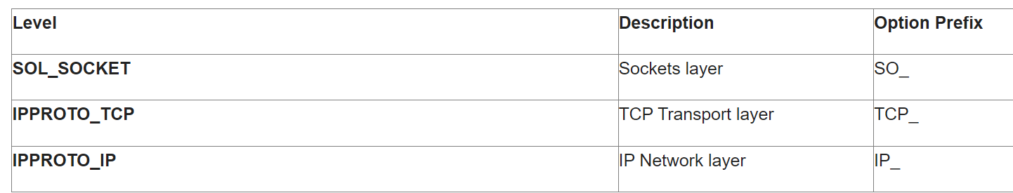
STANDARD SOCKET OPTION LEVELS

Slide 12
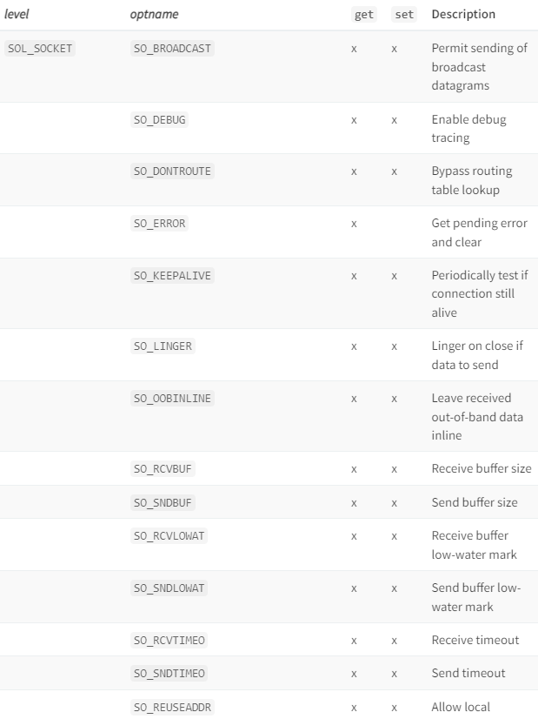
Socket level & It’s corresponding options

Slide 13
Thank you

